Slide 1
Usability Testing
Notes from
http://www.usability.gov/methods/test_refine/learnusa/index.html

Slide 2
Learning objectives
Be able to articulate why and when to do usability testing
Be able to develop usability testing plans (continues next lecture)
Be able to write usability test reports (continues next lecture)

Slide 3
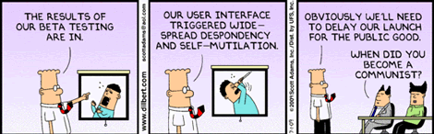
Usability Testing
Testing it with representative users
users will try to complete typical tasks while observers watch, listen and take notes.
Goal is to identify any usability problems
collect quantitative data on participants' performance (e.g., time on task, error rates)
determine participant's satisfaction with the product.
http://www.90percentofeverything.com/2009/07/24/more-dilbert-on-user-experience/

Slide 4
When to Test
You should test early and test often. Usability testing lets the design and development teams identify problems before they get coded (i.e., "set in concrete”). The earlier those problems are found and fixed, the less expensive the fixes are.
Test as much as possible with paper prototypes
Main flow (fit to user’s notion of natural workflow)
Interface metaphor (the ‘big picture’ of the look and feel)
Key screens where most of the work will get done

Slide 5
Role of the usability test
In design
Early, often, informal, preferably with paper prototype to get the right product concept
As the design progresses
Working prototypes, more formal
Feedback to design team and broader project management on areas and priorities for change
In product selection
Will this product work for your organisation (or your client)?
Where is it at variance from ideal? Can the vendor address these issues and/or the client cope with them??

Slide 6
How to test
Know what your goal is (actually this is true for all usability evaluation methods – heuristic, performance measure-based [e.g. Fitts’ Law] or participant based)
Focus on whatever you believe are the key aspects, e.g.
Navigation
Specific task
Perfecting a specific (novel or critical) control
Set the task accordingly
Recruit participants
Observe
Record (specialised tool: Morae – In a later tutorial)
Co-located, or Remote

Slide 7
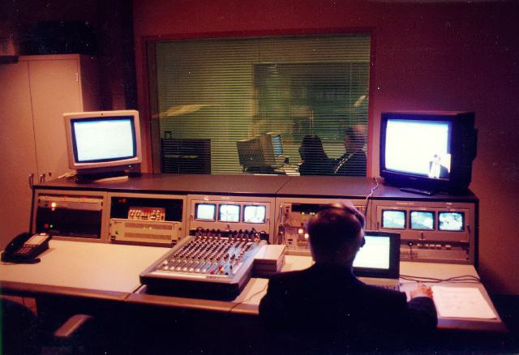
Old-fashioned deluxe usability lab
Still, can be handy to get thorough documenta-tion of a test!

Slide 8
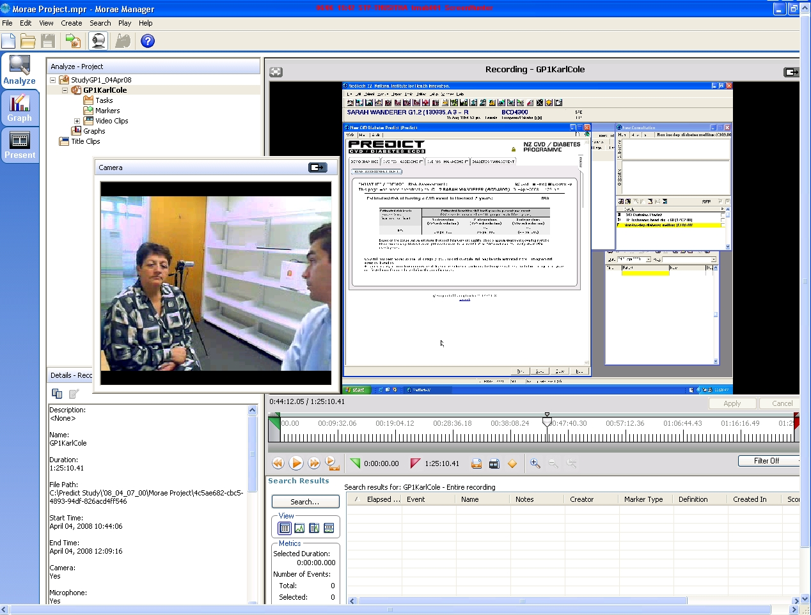
Example of a Morae screen (real GP, actor as patient, cardiovascular risk assessment task)

Slide 9
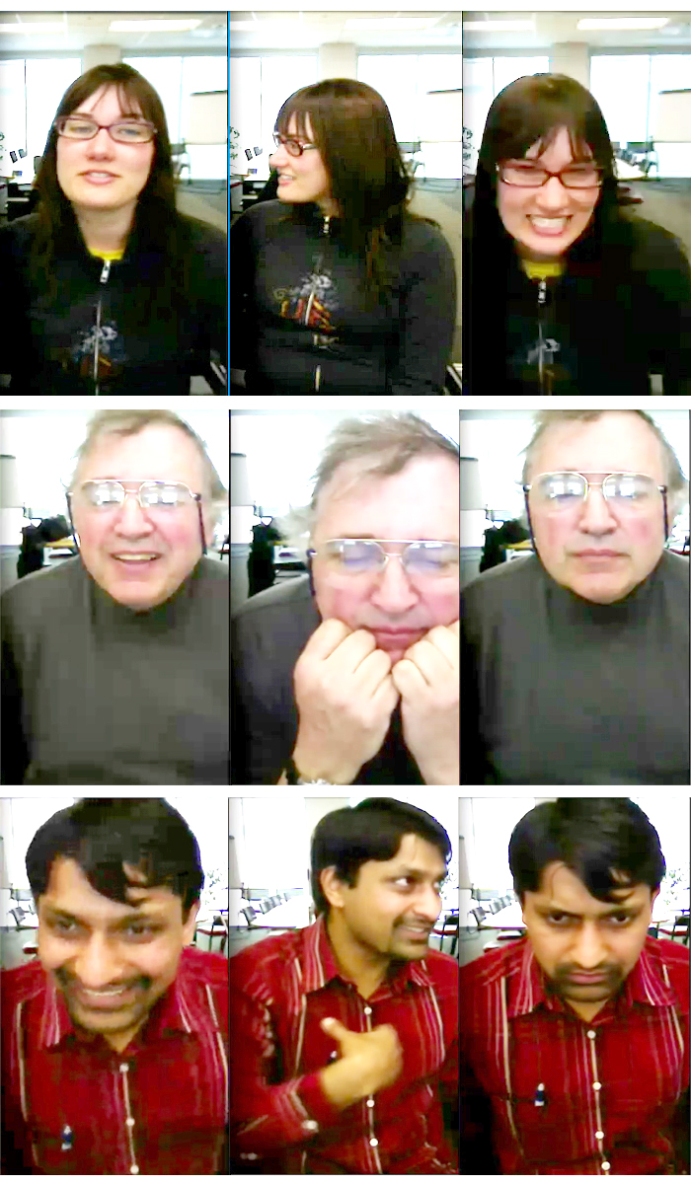
Remote usability testing
Nowadays you can do a usability test with all or part of the evaluation team in another country!
Log audio and video of user
And log synchronized video of action on screen

Slide 10
What You Learn
About completing routine tasks successfully
How long it takes to do that
Where people run into trouble
What sort of errors they make
How satisfied participants are with your interface
Helps to identify changes required to improve user performance
Alas, finding a problem doesn’t automatically hand you the answer, but at least gives you a focus for re-design / iterative refinement
Measures the performance to see if it meets your usability objectives

Slide 11
Making Use of What You Learn
Someone designed what you are testing
They may be defensive / offended that their design isn’t already perfect.
Usability testing is not just a milestone to be checked off on the project schedule. The team must consider the findings, set priorities, and change the prototype or site based on what happened in the usability test.
Find the Best Solution
Most projects, including designing or revising computer interaction, have to deal with constraints of time, budget, and resources. Balancing all those is one of the major challenges of most projects.

Slide 12
Usability testing results
Tabulate what you find (again, also true for other usability evaluation – e.g. scores on heuristics)
Individual and mean scores of performance measure, error/problem counts, and questionnaire responses
On a larger scale you may use statistics such as 95% confidence intervals and ANOVA versus ‘control’ (comparison) type of interface
Include video
Otherwise the designers might not believe your ‘spin’
Reach conclusions
Summarise the data into major (and minor) issues

Slide 13
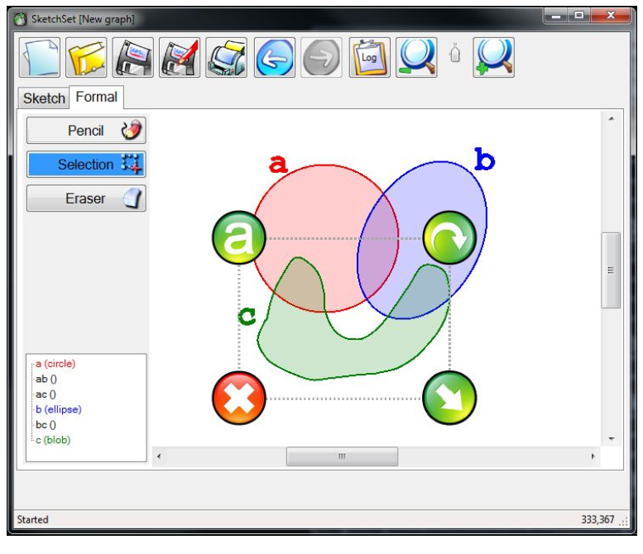
Iterative evaluation
Big problems mask little ones (sample from Beryl’s work)

Slide 14
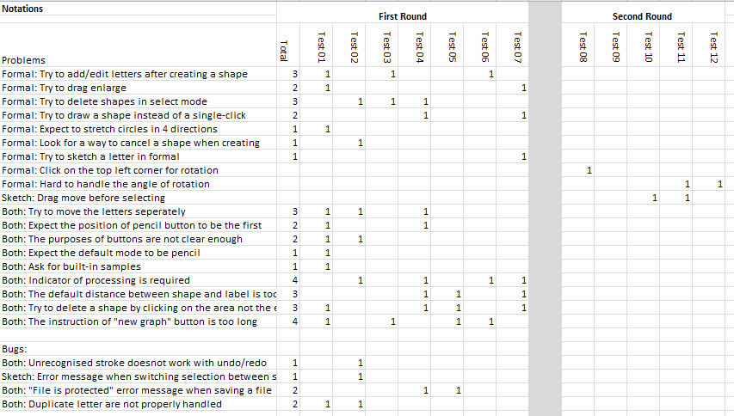
Round 1 and 2 results

Slide 15
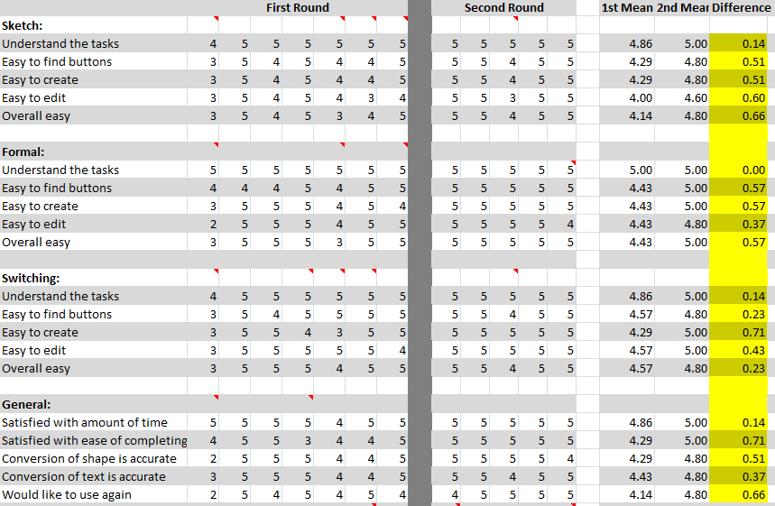
Improved User Satisfaction!

Slide 16
Results summary
It is often difficult to sell your results
Numbers are convincing
Video of puzzled users is very compelling
Summarise and prioritise problems found

Slide 17
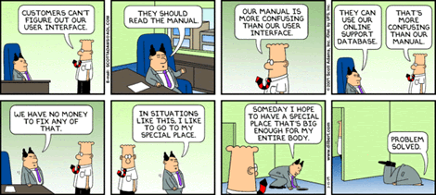
Tips
Testing the site / app, NOT the Users
http://www.90percentofeverything.com/2009/05/26/dilbert-on-user-experience/

Slide 18
Test Planning
A good plan is absolutely essential for a good test and defendable results
The higher the stakes, the better the plan needs to be
In early iteration for design it might be quite informal
Remember: test early and often
As we move from design to prototype to pre-market product the formality picks up
Can also do formal testing as part of product selection, too
It’s much more common to be selecting a product to get a job done than to be perfecting a product for market
Even a software shop might purchase a leave booking system

Slide 19
Selecting ‘users’
Who are the users for a usability test?
People you can get!
Have a recruitment plan
Dissemination, incentive
Runs into research ethics – do they know what they’re in for? Can they say no?
Are they representative of your intended user base?
YOU, for instance, are probably almost perfectly wrong for it (IDE interfaces aside) in terms of skills and intrinsic understanding of the product and its design (you know too much!)
Heuristic evaluation and performance measurement are (valuable!) ways to side-step the issue of user selection
Replace user with an expert, or a model

Slide 20
Summary
Usability testing
Why
When
How
Results
Effectiveness

